Slide 1
Trend analysis of sulphur and nitrogen species in air and precipitation in Sweden
Martin Ferm 2015-05-07

Slide 2
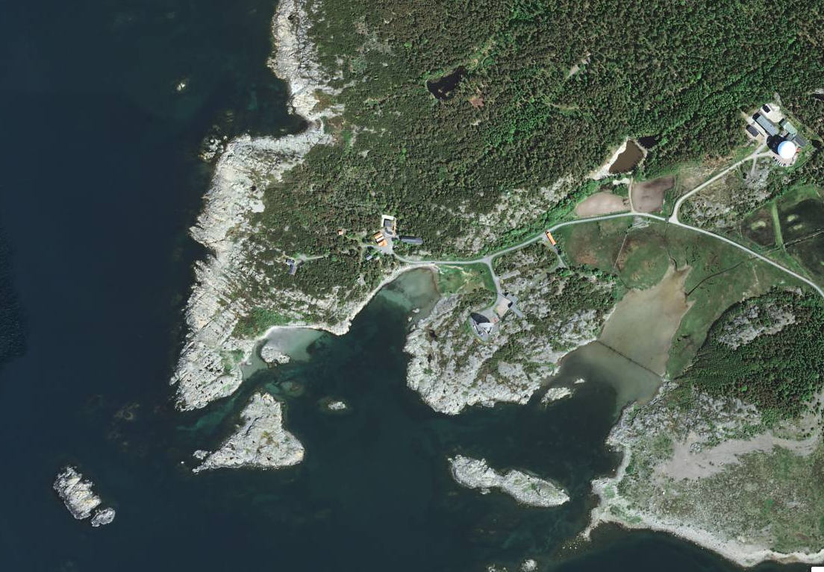

Slide 3
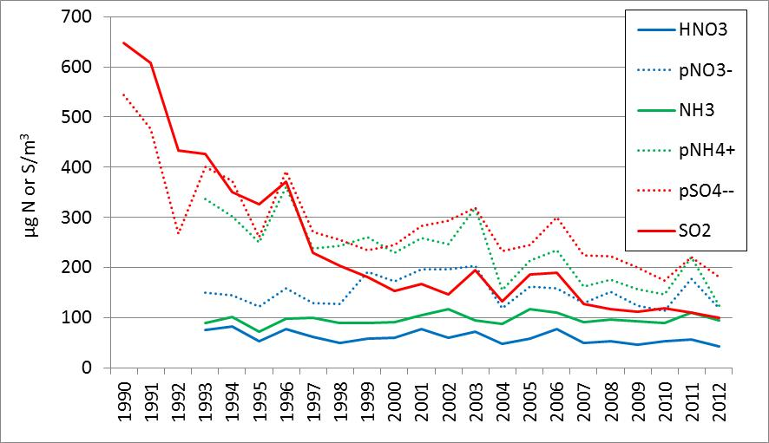
Trends in air concentrations
The strong decrease in particulate ammonium concentrations is
caused by the decreased particulate non-marine sulphate concentrations

Slide 4
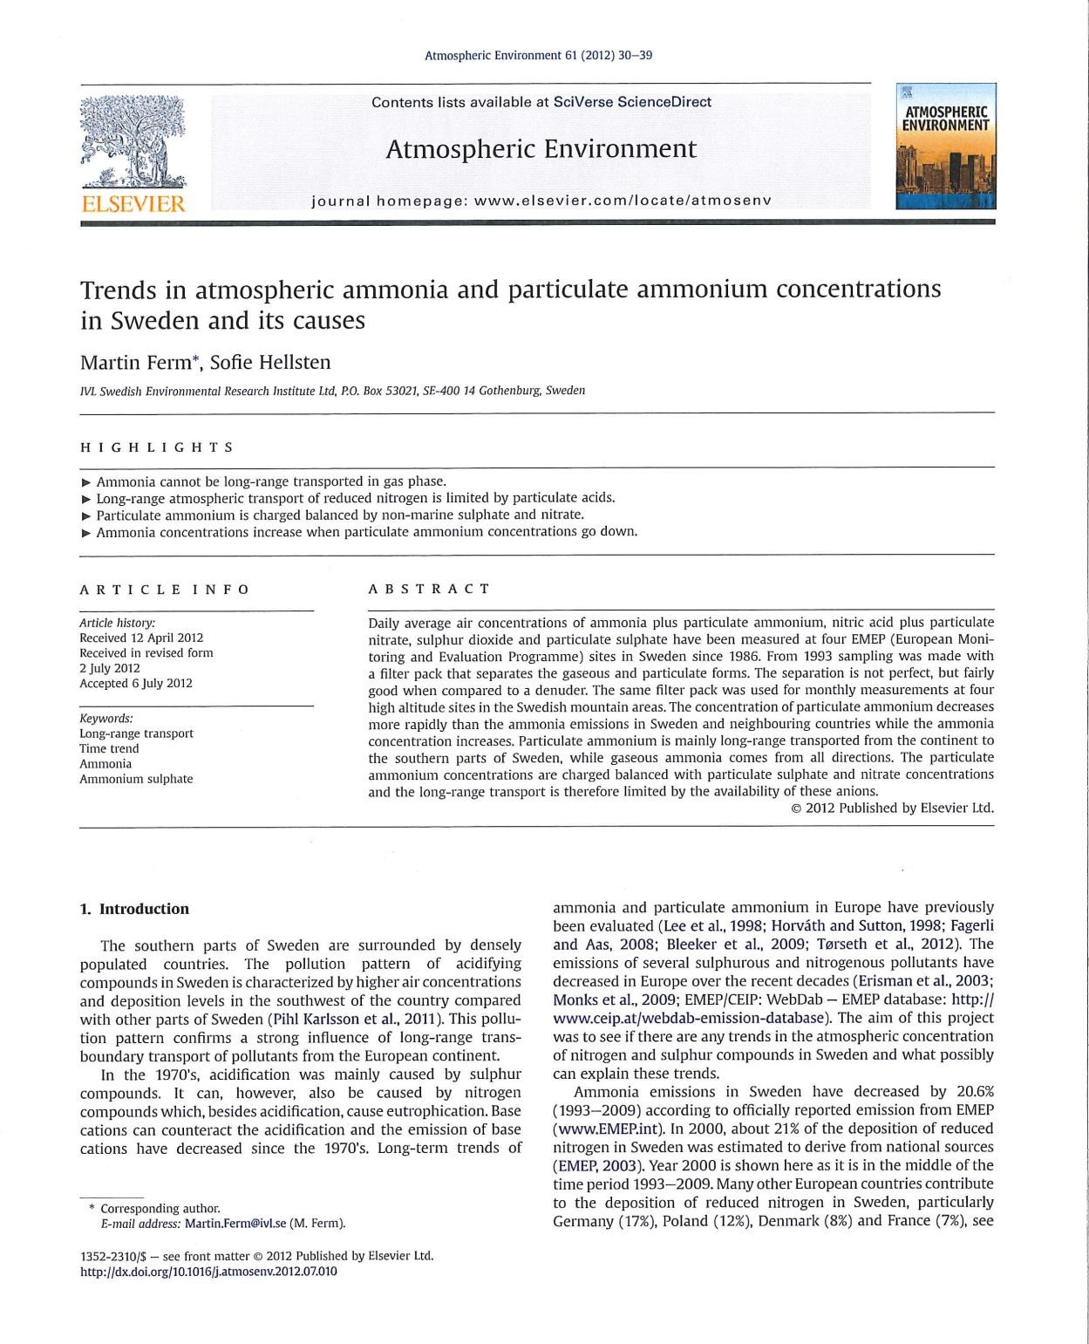

Slide 5
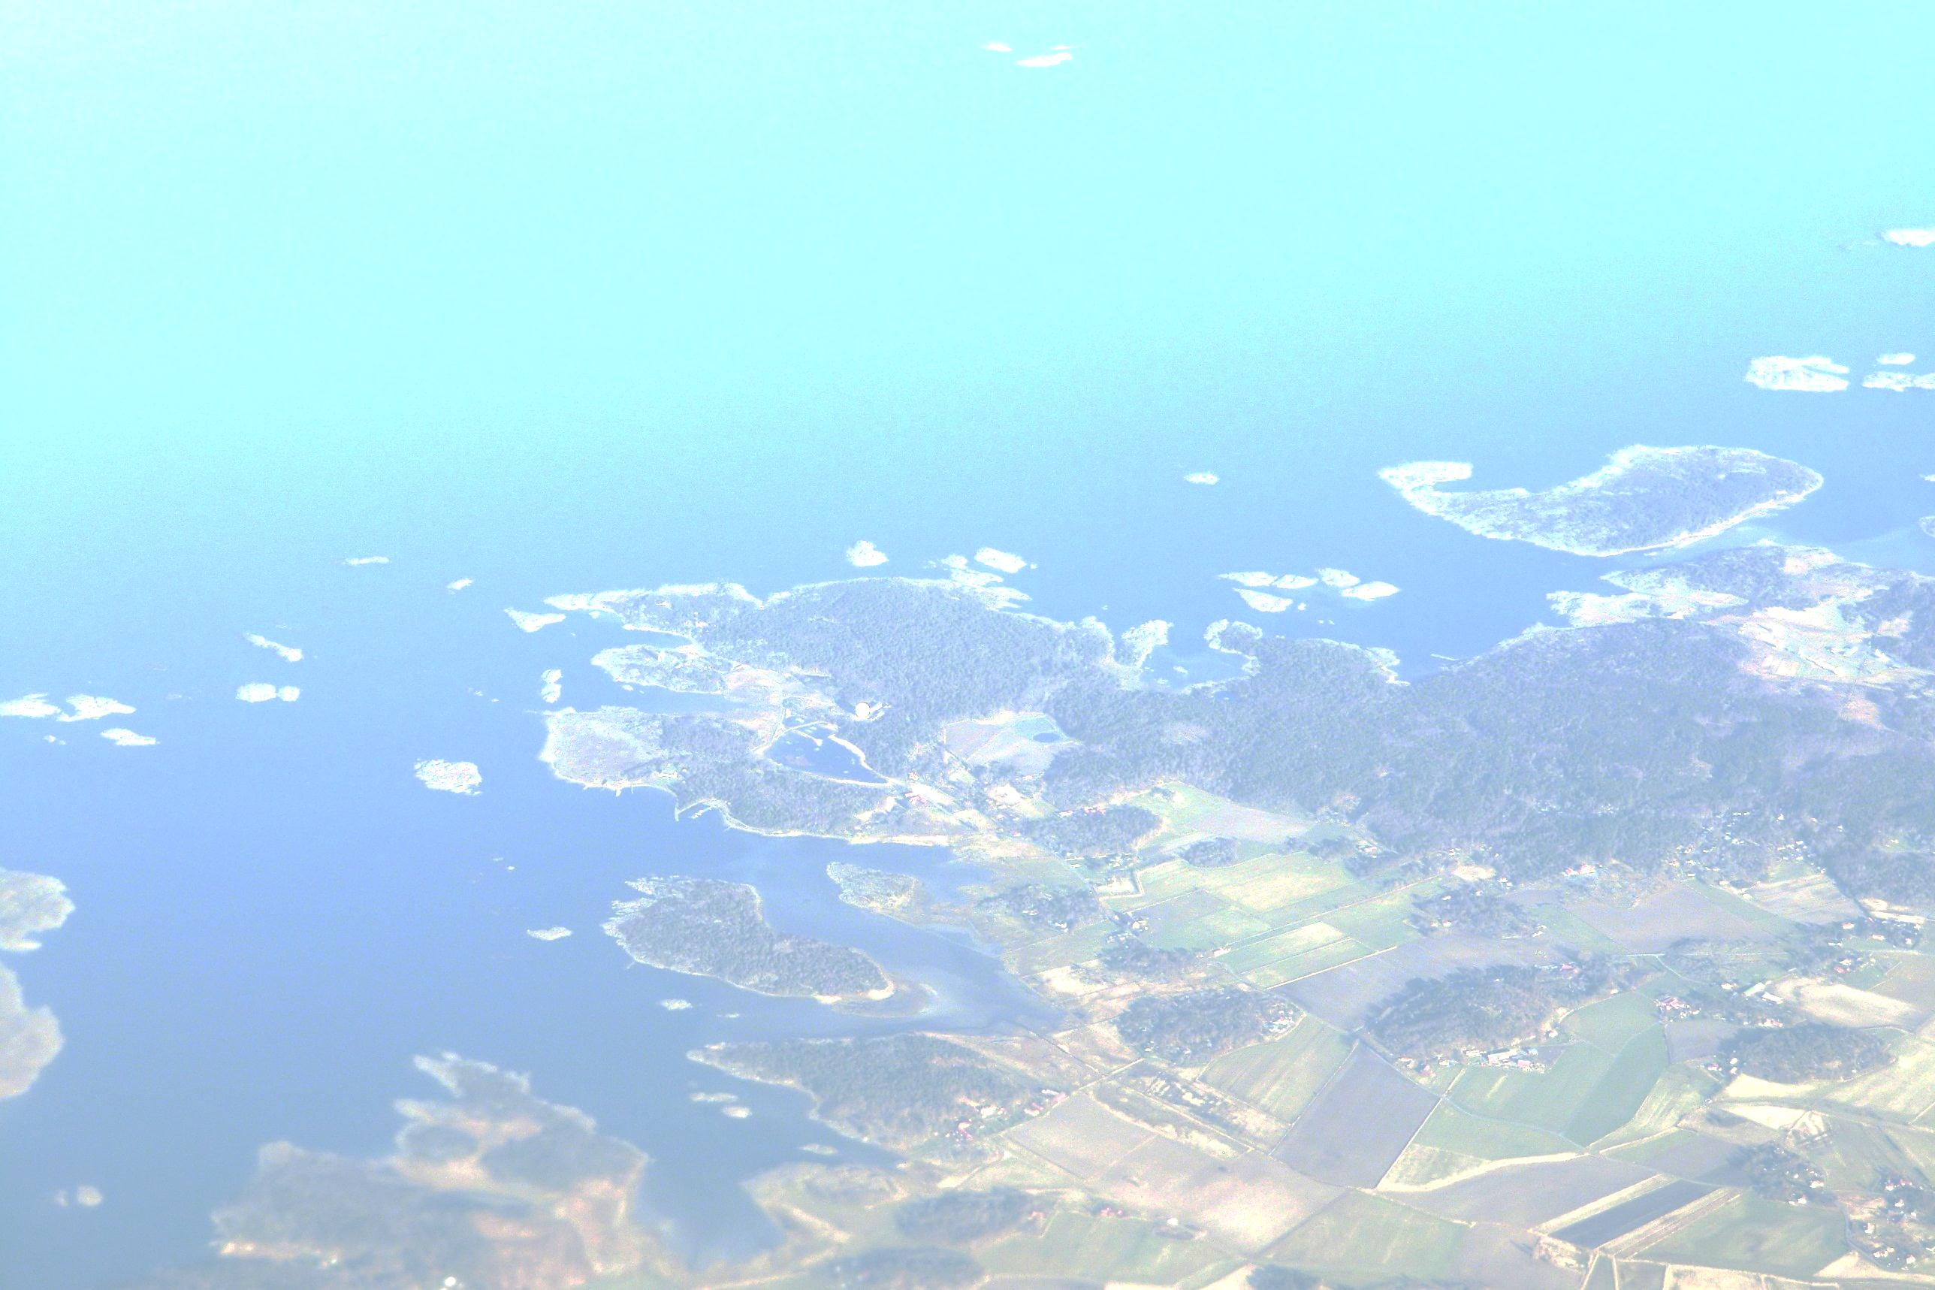



HNO₃, NO₃⁻
SO₂, SO₄²⁻
NH₃, NH₄⁺

Slide 6
What is the relationship between the concentrations in air and precipitation?
How does the daily precipitation amount affect the deposition and the
air concentrations near the surface?
Only 44 % of the days between 1990 and 2012 = 3650 days had precipitation.
The average daily prec. amount was 4.4 mm

Slide 7
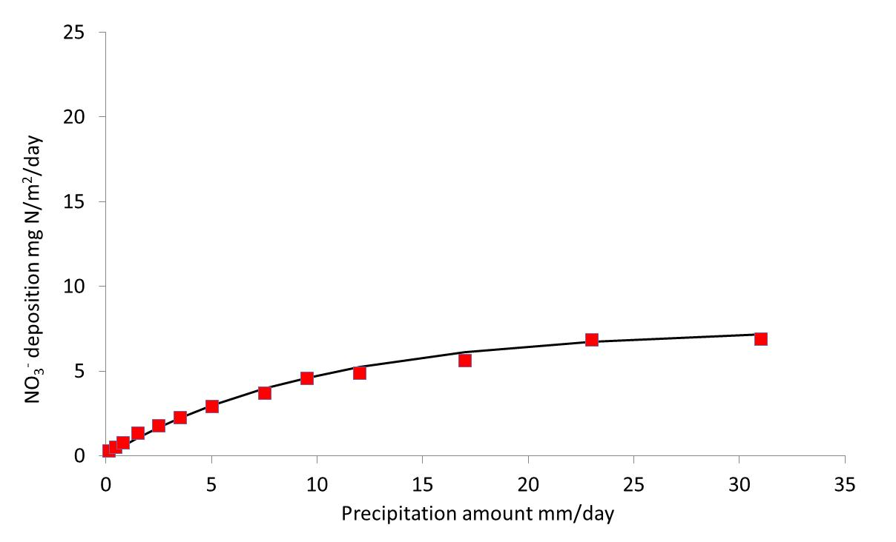
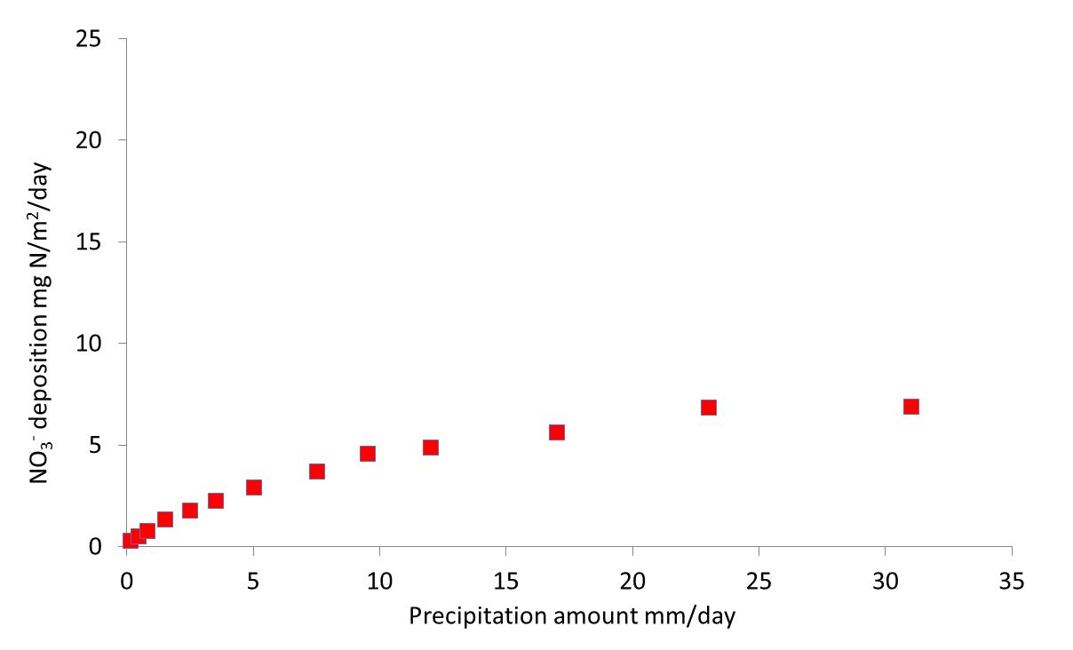
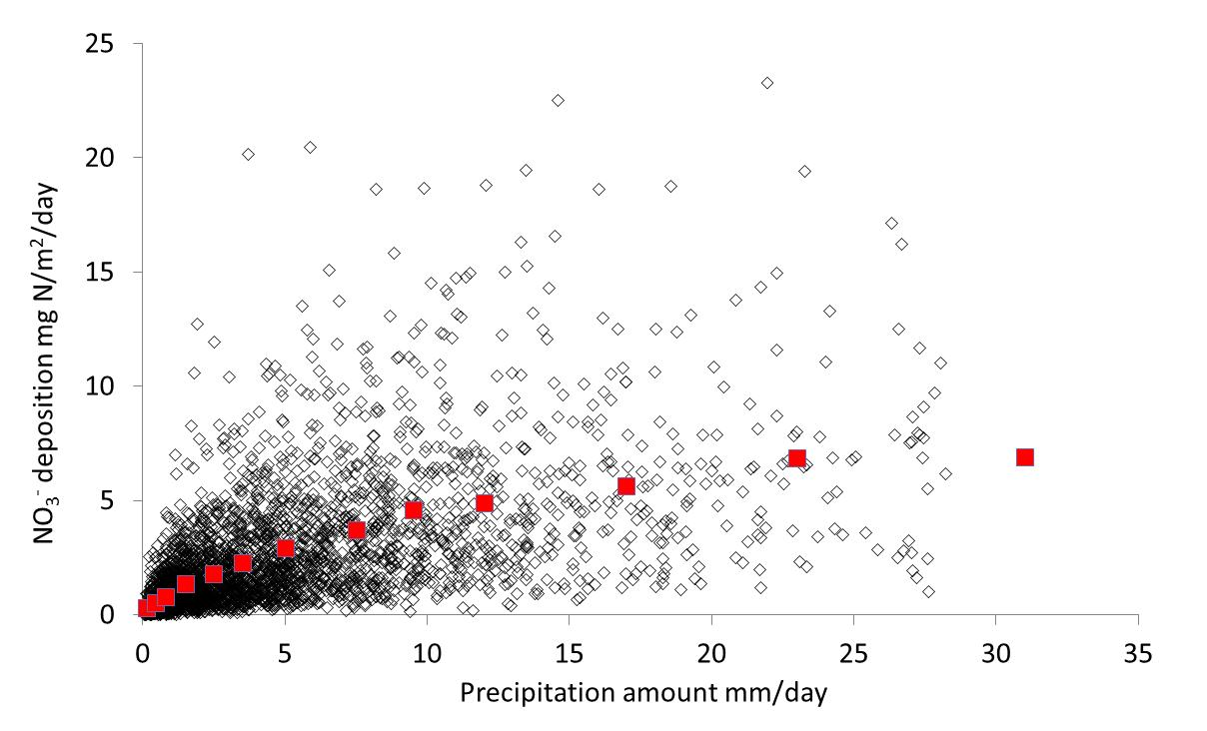
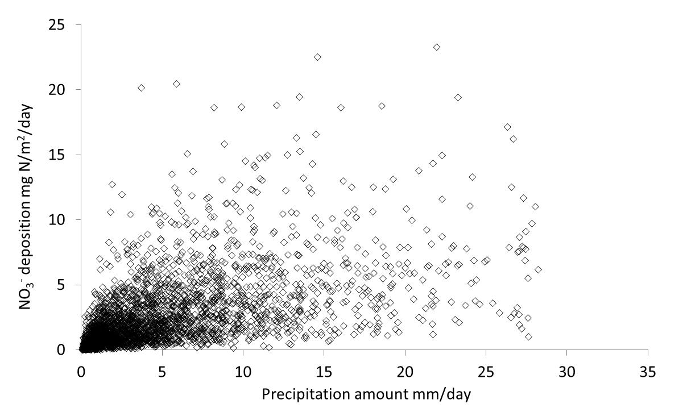
Deposition = a·e^{-b∙P}

Slide 8
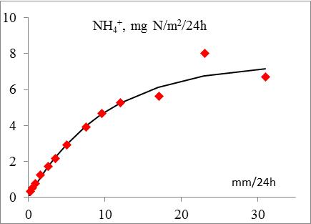
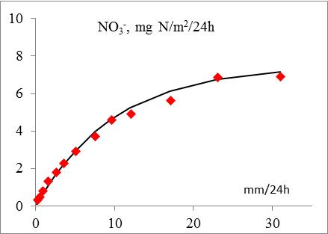
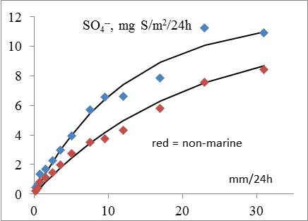
How does the precipitation amount influence the wet deposition?
(3650 days with precipitation 1990-2012, average daily prec. amount = 4.4 mm)

Slide 9
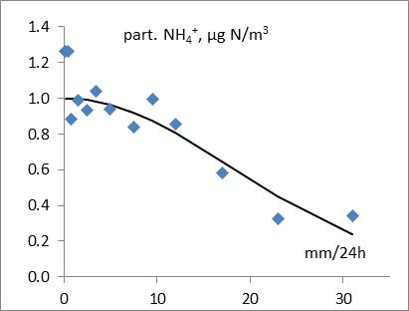
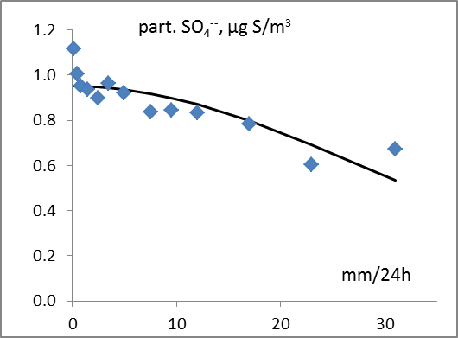
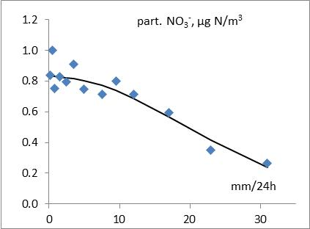
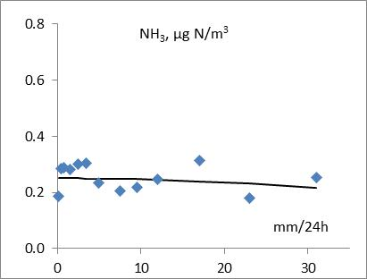
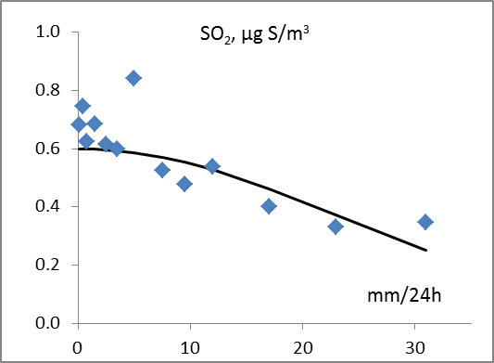
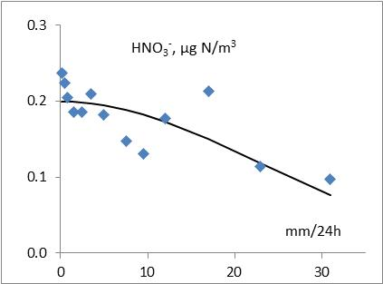
Average concentrations in air 1990-2012 as a function of daily precipitation amount, when the air trajectory comes from southwest.

Slide 10
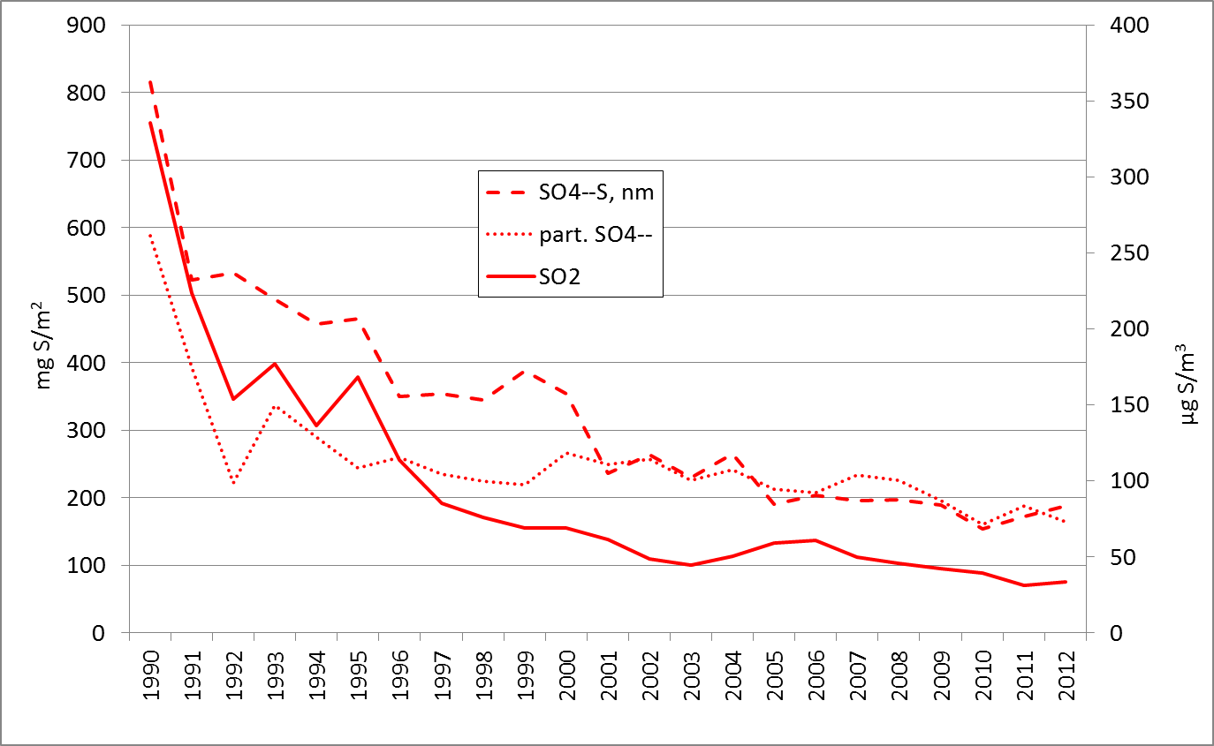
Wet deposition and air concentrations only during days with precipitation
The wet deposition shows a stronger trend than particulate sulphate and
a weaker trend than SO₂.

Slide 11
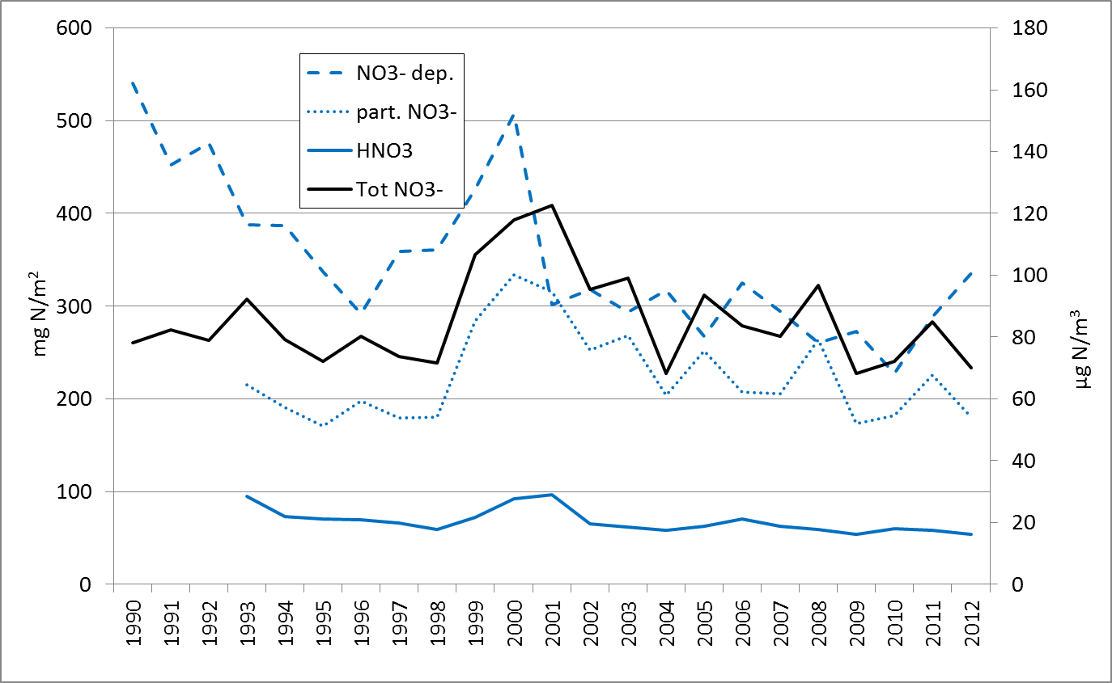
Wet deposition and air concentrations only during days with precipitation
Nitrate shows a stronger trend than its precursors in the same oxidation number.

Slide 12
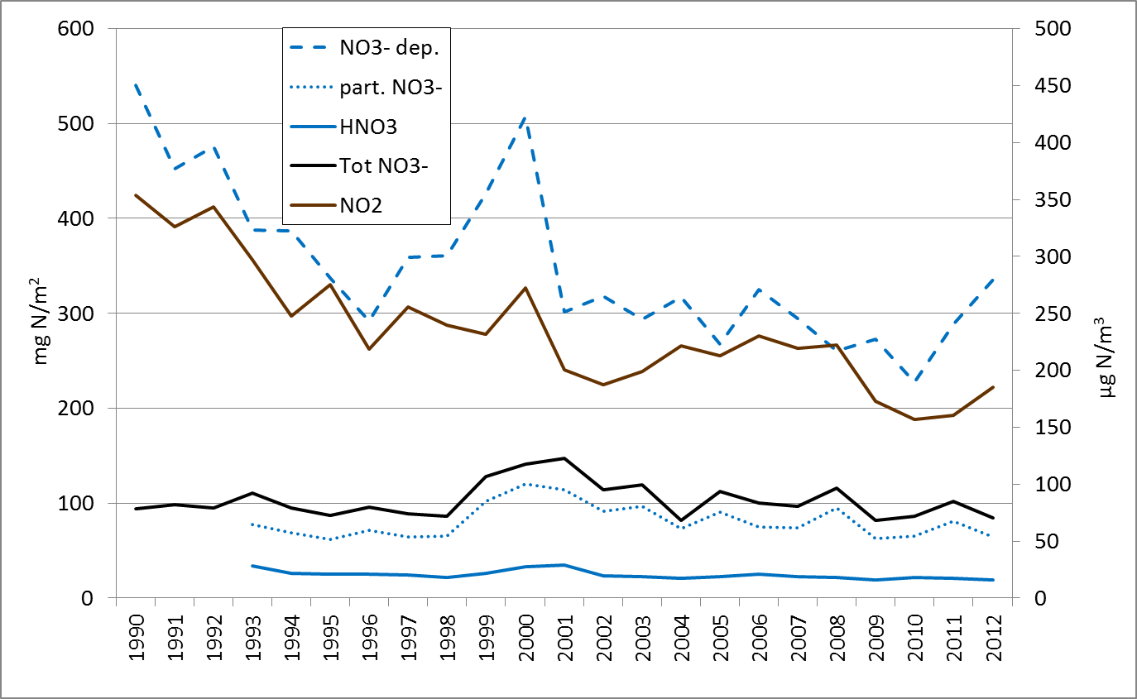
Wet deposition and air concentrations only during days with precipitation
Can NO₂ be oxidizes in clouds?

Slide 13
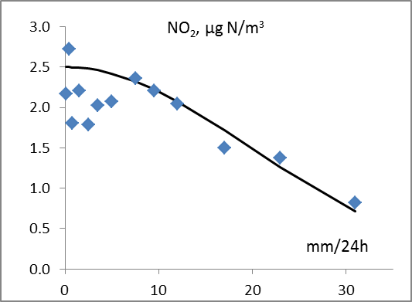
Average concentrations in air 1990-2012 as a function of daily precipitation amount, when the air trajectory comes from southwest.
Can NO₂ be oxidizes in clouds?

Slide 14
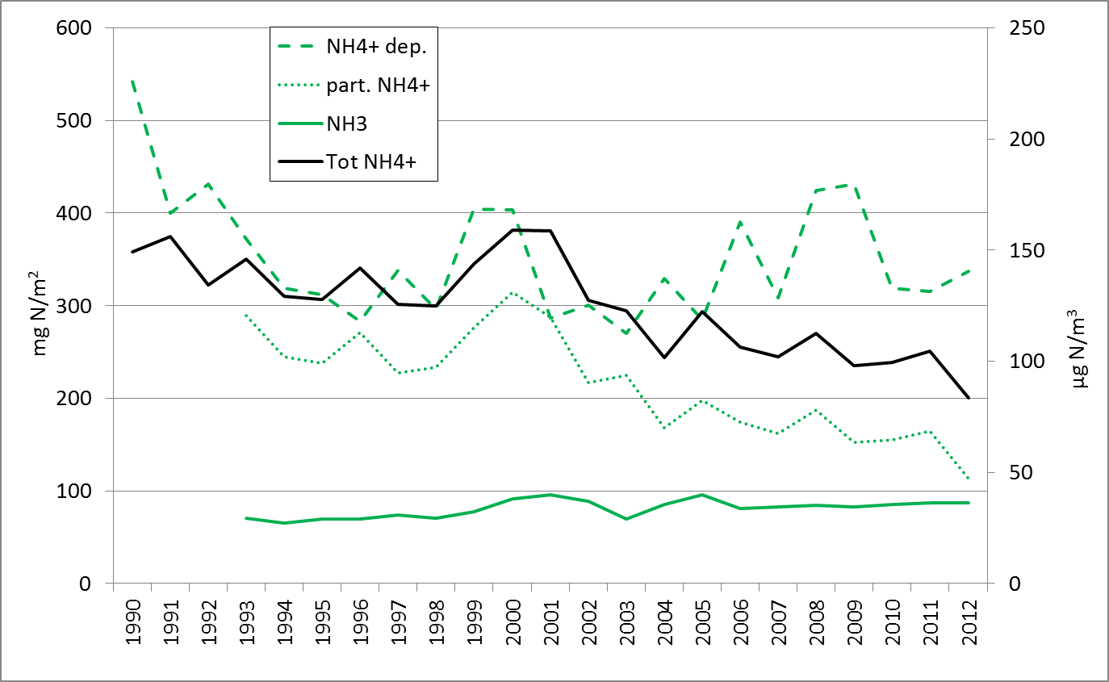
Wet deposition and air concentrations only during days with precipitation
Ammonia needs acidic particles or acidic rain to travel long distances in the air.

Slide 15
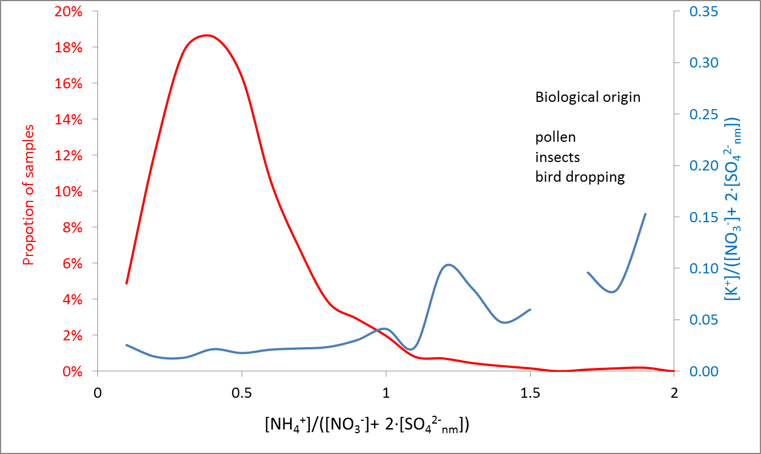
[NH₄⁺]/([NO₃⁻ + 2·[SO₄²⁻_{nm}]) < 1.5 (98.5 % of all ion balances)
and
[K⁺]/([NO₃⁻]+ 2·[SO₄²⁻_{nm}]) > 0.1

Slide 16
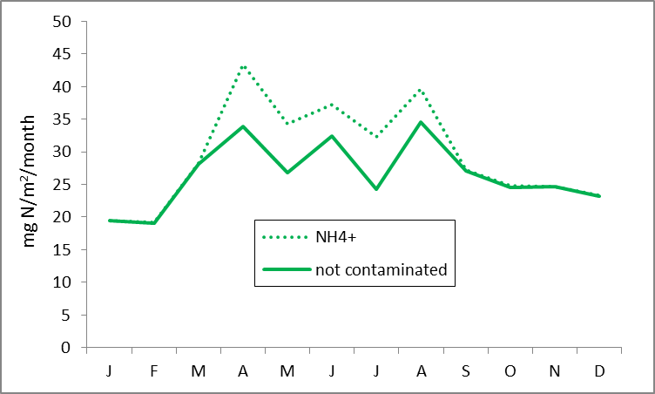
The migratory birds, insects and pollen are all here

Slide 17
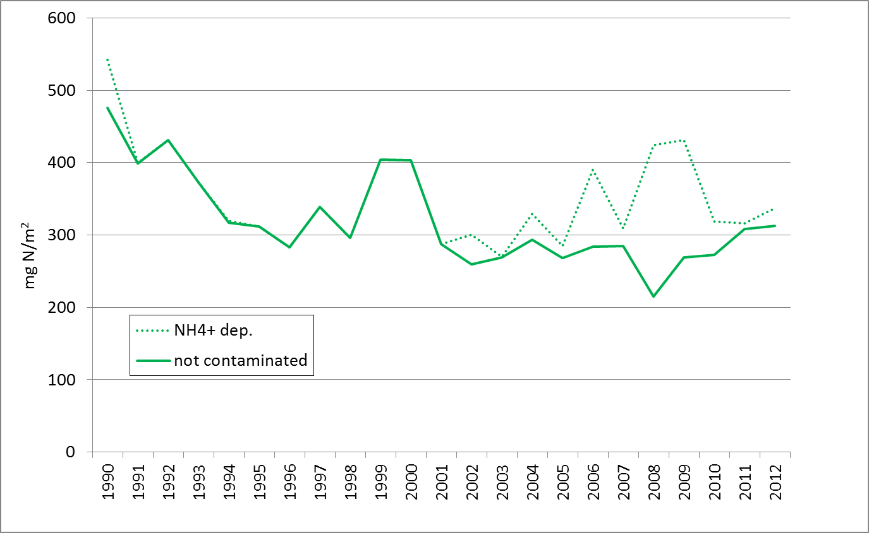
In 2002 the station moved from Rörvik to Råö

Slide 18
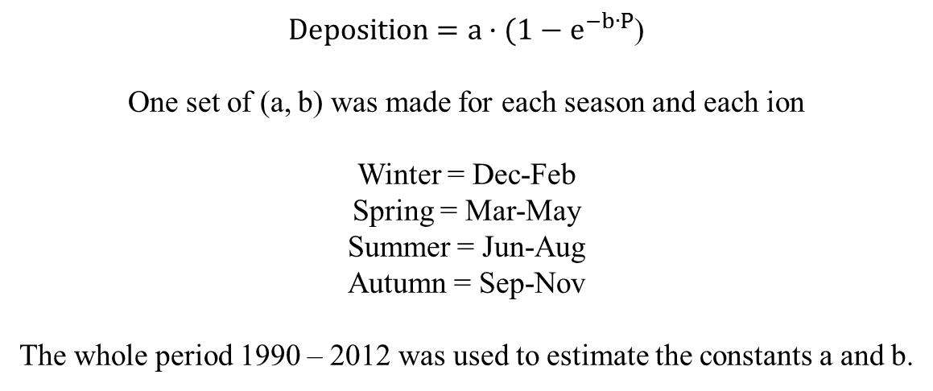
An attempt to reduce the inter-annual variations in wet deposition has bee made.
$Deposition=a·(1−e^{−b∙P}$)
One set of (a, b) was made for each season and each ion
Winter = Dec-Feb
Spring = Mar-May
Summer = Jun-Aug
Autumn = Sep-Nov
The whole period 1990 – 2012 was used to estimate the constants a and b.

Slide 19
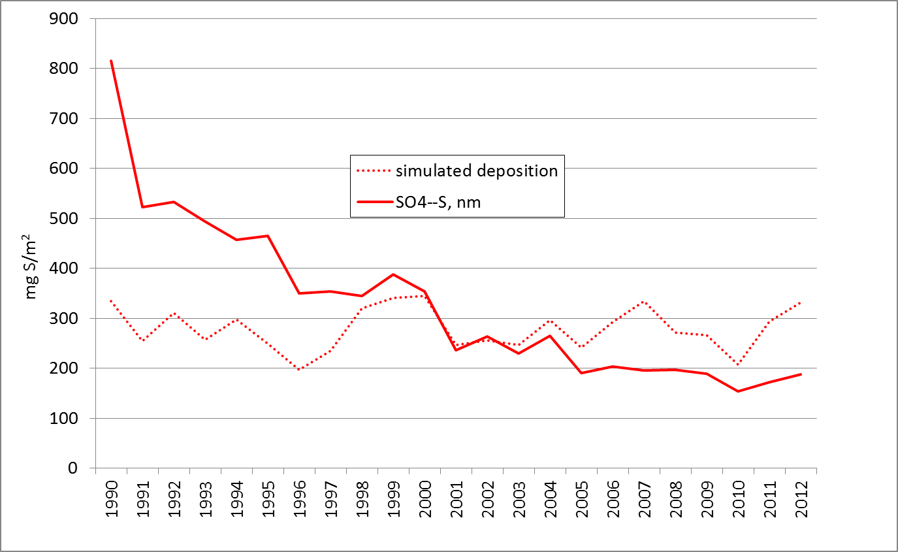

Slide 20
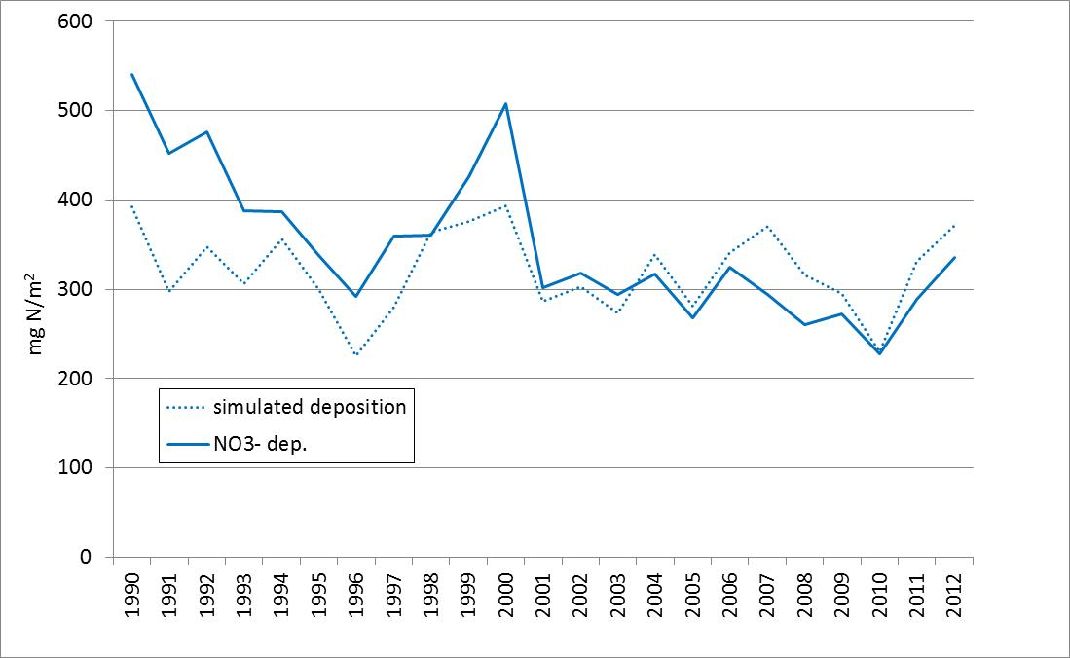

Slide 21
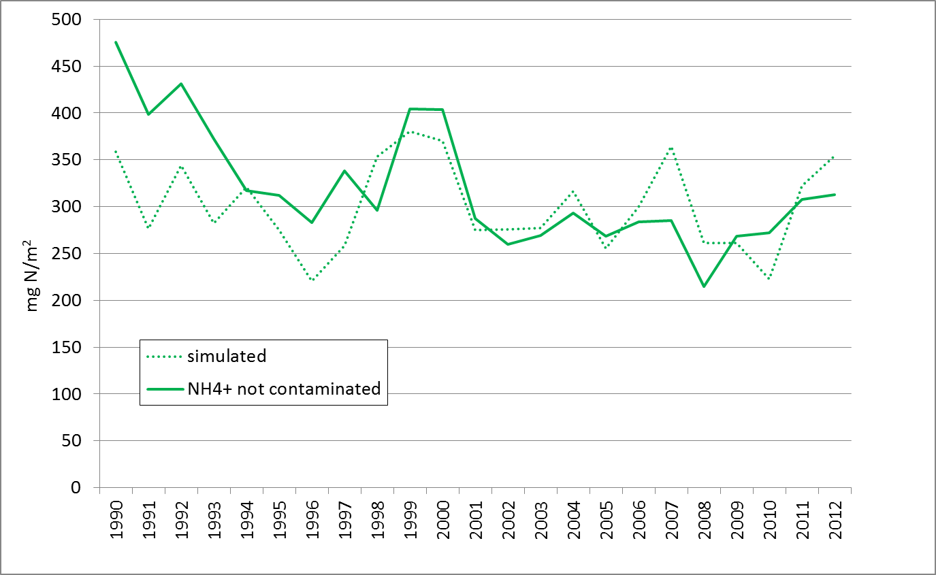

Slide 22
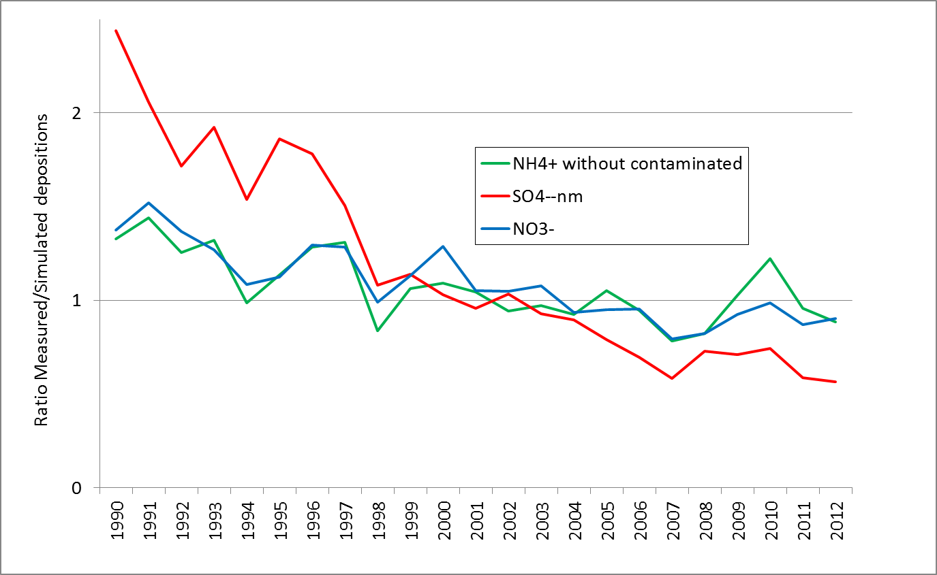

Slide 23

Mann-Kendall analysis

Slide 24
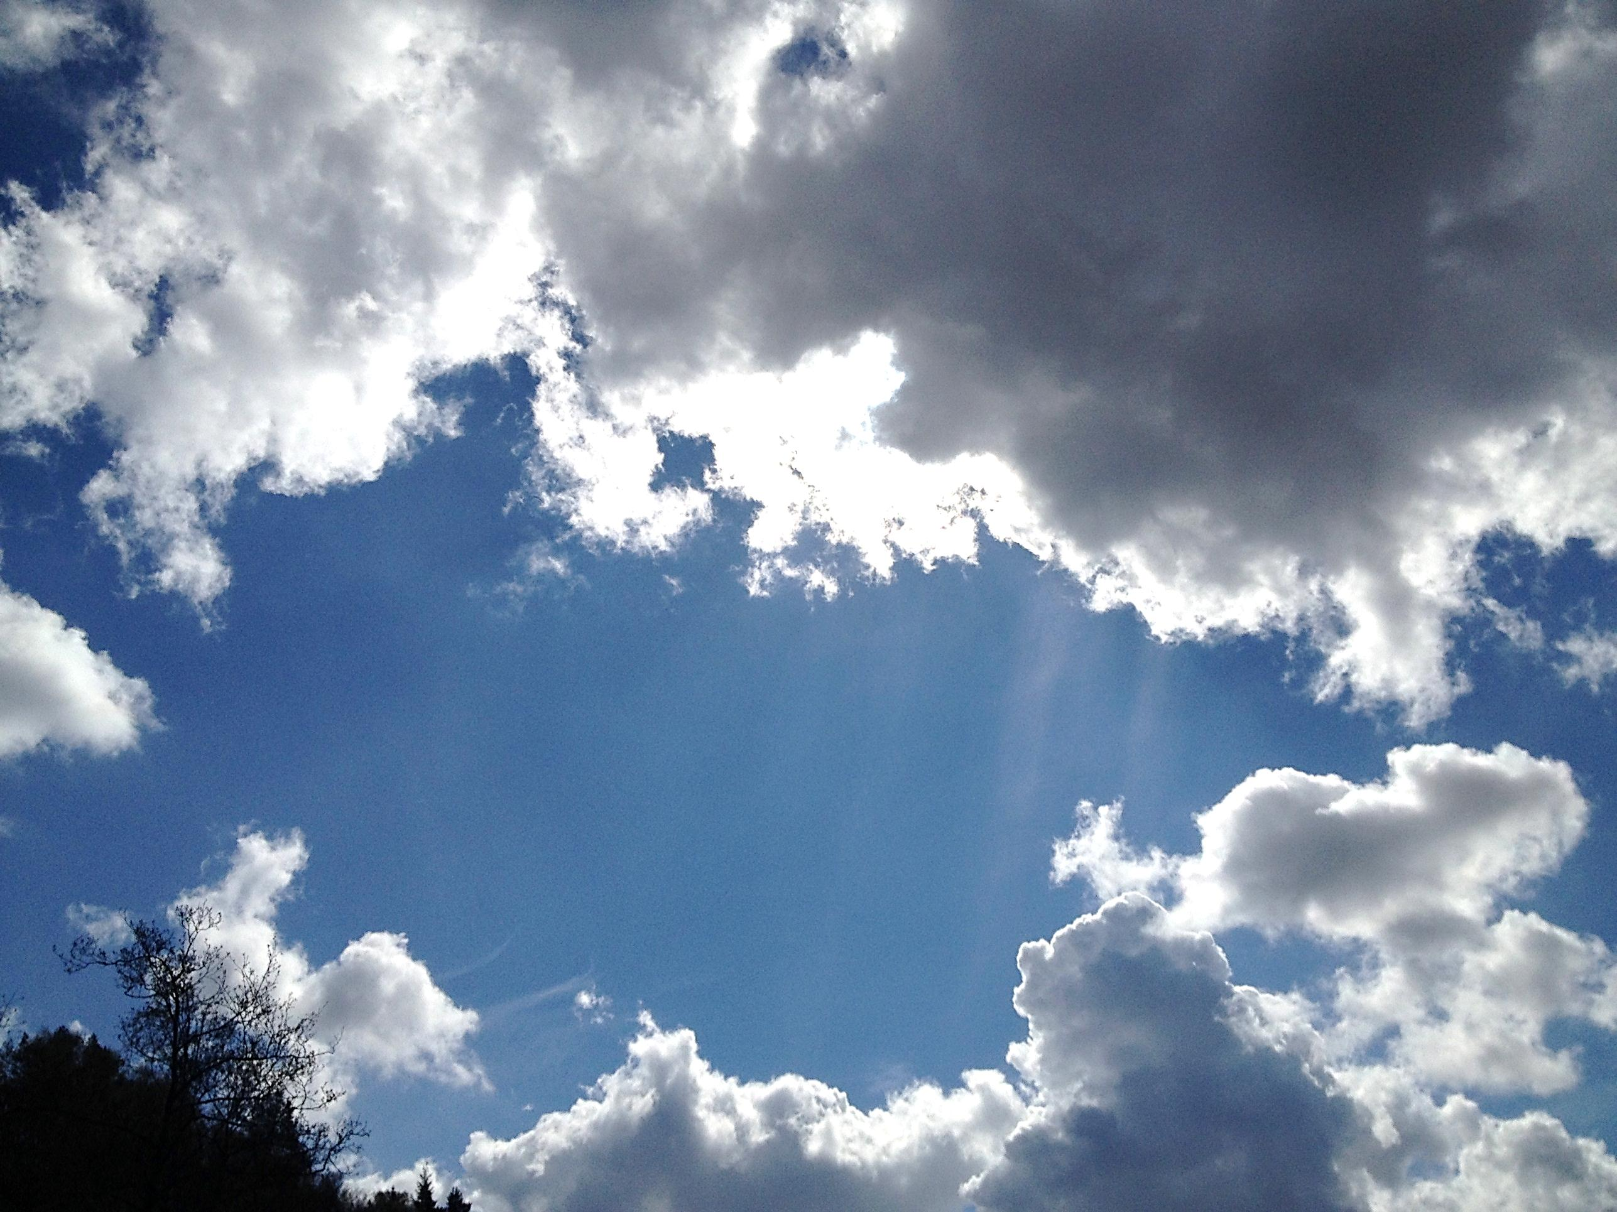
Thank you for your attention!

